Slide 1


CONTOSO
Industry Sandbox Group Project
INFS5700 Introduction to Business Analytics
Notes:
This Project is presented by the above students for the Industry Sandbox Group Project on Contoso Hotel Franchise.

Slide 2
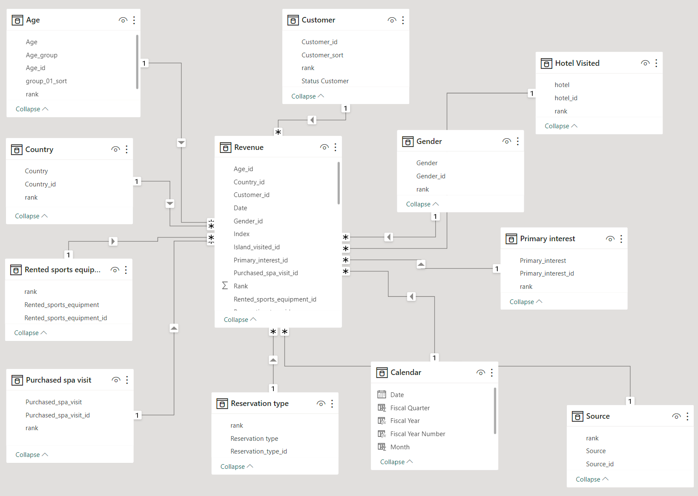
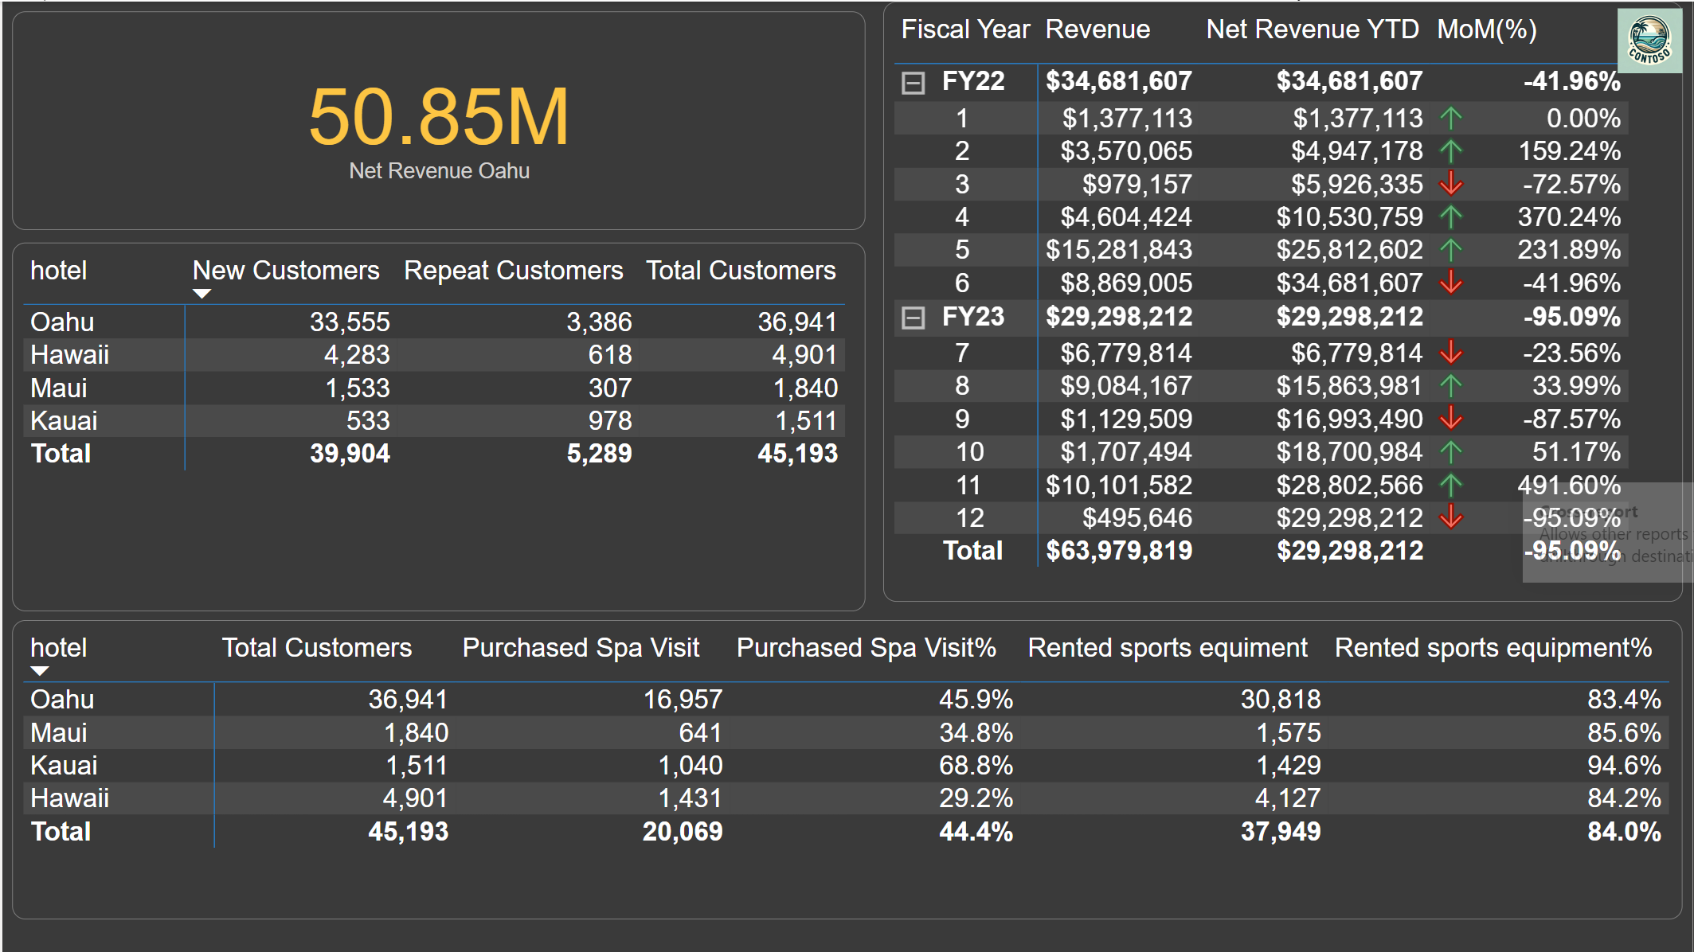
Introduction and DAX
DAX
Notes:
Good day, everyone,
I'm here to share insights into our recent Power BI assignment, a project that allowed us to dive deep into the world of data analytics. I’ll be covering four key areas today: Introduction, Data Cleaning, our Star Schema, and the application of DAX.
Introduction: Our project was an endeavor to transform a dataset into a meaningful narrative. Our goal was straightforward: to learn how to make data speak through visualizations and analytics that could potentially inform business strategies.
Data Cleaning: This initial phase might seem trivial, but it's the bedrock of reliable analysis. We ensured our dataset was free from duplications and inconsistencies. This foundational step set the stage for all the complex analyses that followed.
Star Schema: As you can see from our star schema (point to diagram), we organized our data model around a central fact table, surrounded by dimension tables like Age, Country, and Gender. This arrangement not only facilitated quick and efficient data retrieval but also made our data model more intuitive for users like us, who are still honing our analytical skills.
DAX: We also got hands-on experience with DAX formulas, which were crucial in creating calculated columns and measures to uncover insights within our data. While the intricacies of these formulas are beyond the scope of this presentation, they were essential tools in our analysis toolkit.
To wrap up, this assignment was not just about cleaning data or connecting tables; it was about the journey of learning to use Power BI to uncover and present stories hidden in the data. It has been an enlightening experience, and I look forward to exploring this field further.

Slide 3
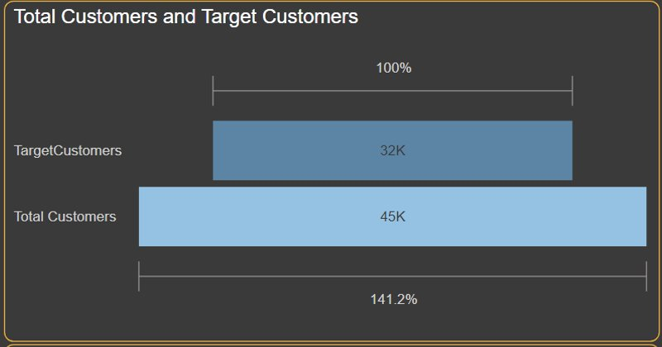
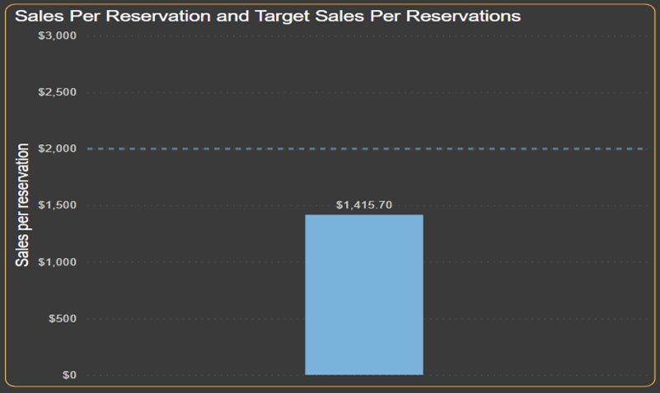
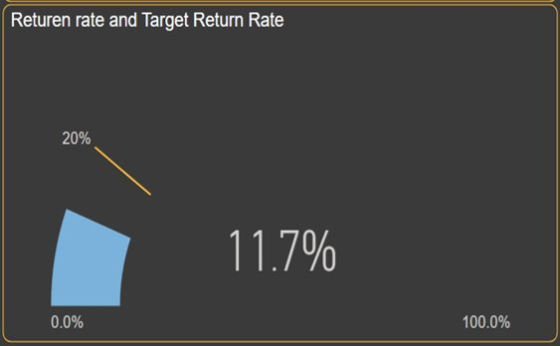
Key Performing Indicators
Notes:
So, These are the Key Performing Indicators that we achieved using the dataset.
The First Chart Indicates the Company's Total Customers and what their target was.
Contoso successfully achieved their Customers Target with a huge difference(41.2%).
Over to the Right, The chart represents the sales per reservations and its target.
Contoso still have to focus more on the factors that are affecting the sales per reservations as the company was unable to achieve the targe.
Focusing on the below Chart, It represents the return rate which is very less compared to that of their target(20%).
Further Slides will be focusing on every aspect in depth.
Target Customers, Sales Per Reservations, Target Sales Per Reservations, Return Rate, and Target Return Rate are created using DAX.

Slide 4
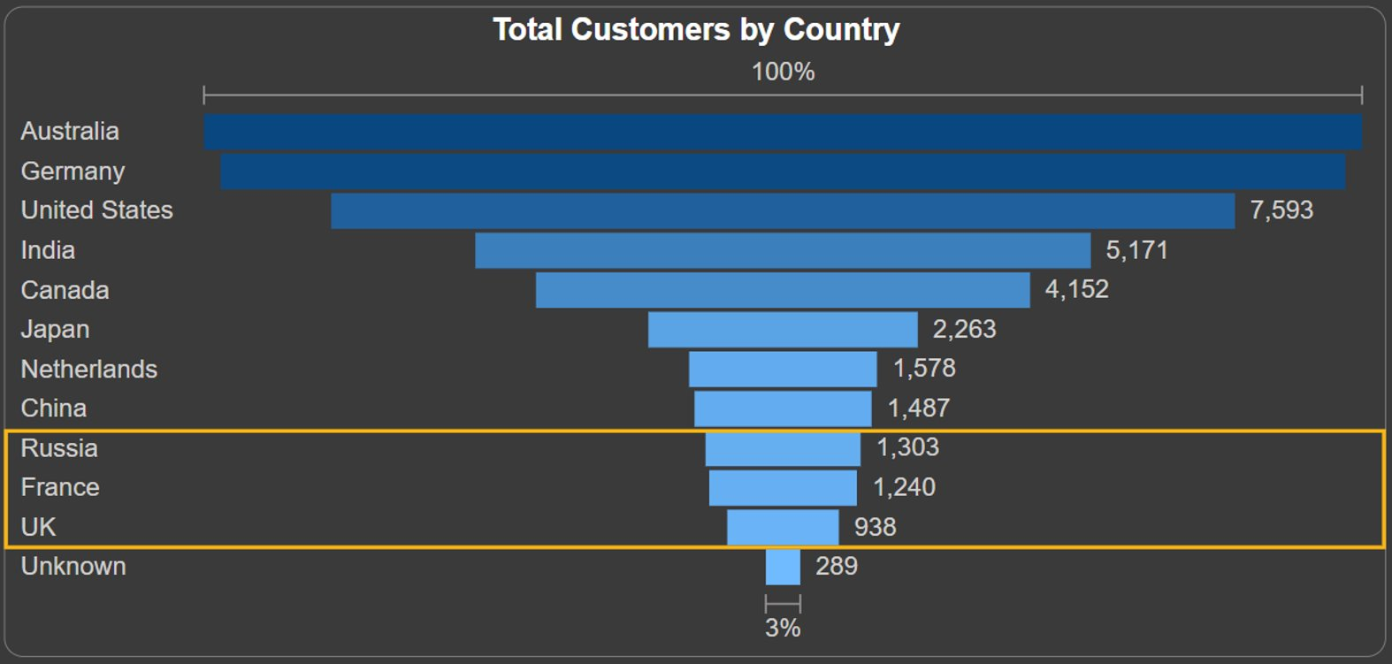
Customer Visits 45193 ➡️ 32000 ✅
Strengthen marketing campaigns that target
the UK, France, and Russia
Notes:
Firstly, it can be seen that Contoso has actually achieved its current target of 32,000 visitors, so the focus of our group becomes how to increase the number of visitors to places that have historically performed poorly, as they have more room for improvement.
In terms of countries, UK, France, and Russia are the three countries where the number of tourists visiting is low, and the company can strengthen the promotion for these three countries.

Slide 5
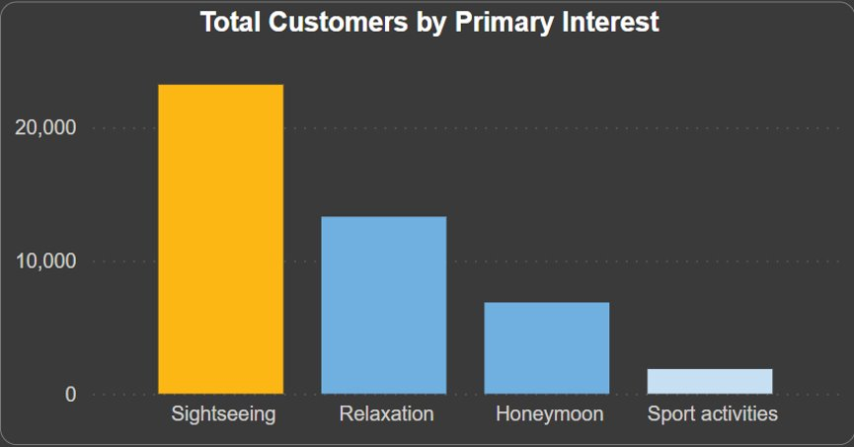
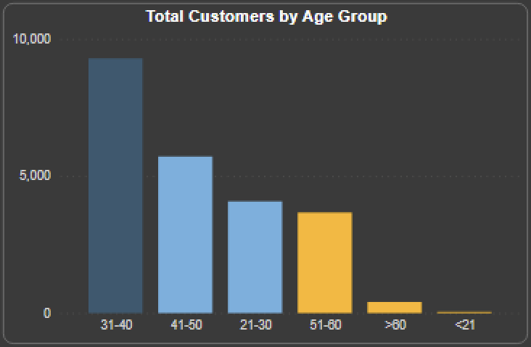
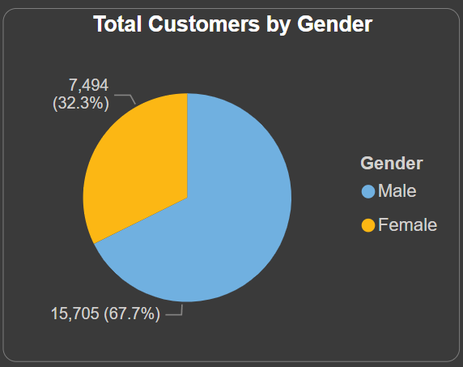
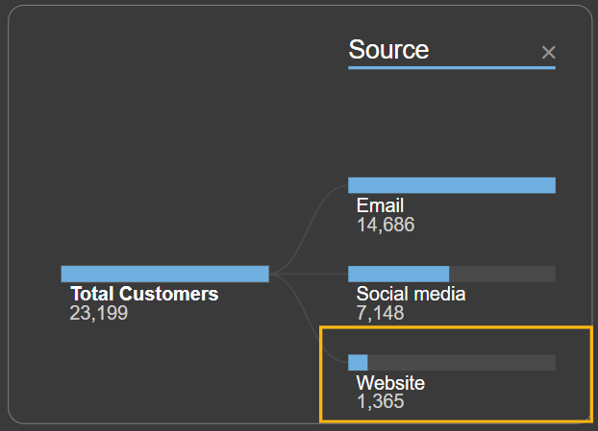
Customer Visits 45193 ➡️ 32000 ✅
Filter by Sightseeing
Increase landscape pictures which are preferred by people(<21 or >50) in advertising
Design and carry out more campaigns that cater to women's aesthetic tastes
Enhance the attractiveness of the web page especially sightseeing aspects
Notes:
Secondly, we analyze it in terms of personal interests, because we cannot easily change the preferences of our customers, what we can do is to increase the attractiveness of what customers are most interested in - the sightseeing. Here we analyze the categories of poor visitor performance in terms of age, gender and customers' access to information.
As shown in the yellow part of the figure. Firstly, we need to investigate what kind of landscape pictures are preferred by people younger than 21 and older than 50, and increase the use of these in advertising; Secondly, design and carry out more campaigns that cater to women's aesthetic tastes; and lastly, enhance the design of the company's webpage to emphasize the advantage of the island's good landscape.

Slide 6
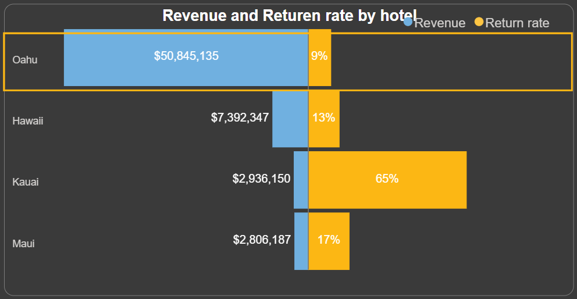
Return Rate 11.7% ➡️ 20%🚩
Filter by All
Notes:
The chart compares revenue and return rate for hotels in four locations: Oahu, Hawaii, Kauai, and Maui.
For Oahu, the revenue is $50,845,135, which is significantly higher than the other locations, with a return rate of 9%. This suggests that Oahu's hotel is generating the most revenue but does not have the highest return rate, which could imply a high volume of unique visitors but fewer repeat customers in comparison to the return rates of other locations.
The emphasis on Oahu and the strategic goal to increase return rates could indicate that while Oahu's hotel is performing well in terms of revenue, there is an opportunity to improve customer retention to drive more consistent business growth.

Slide 7
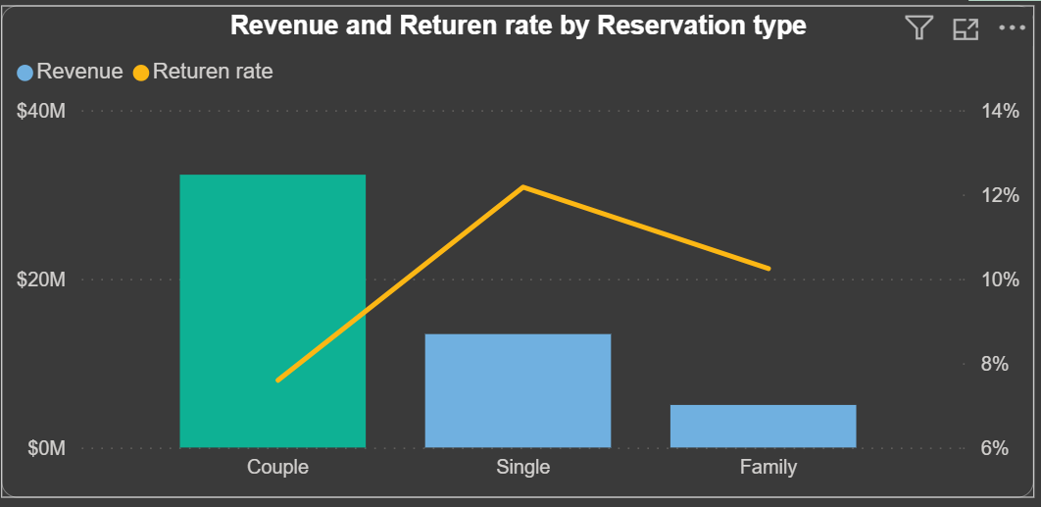
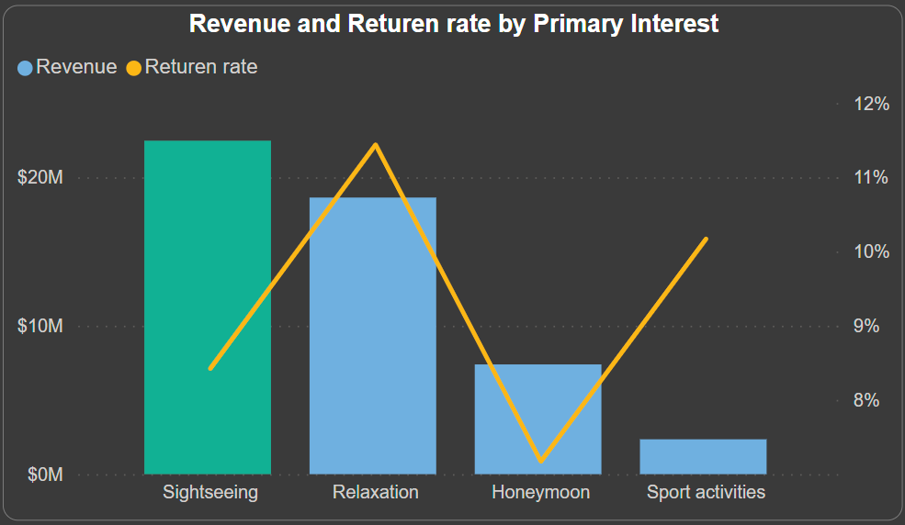
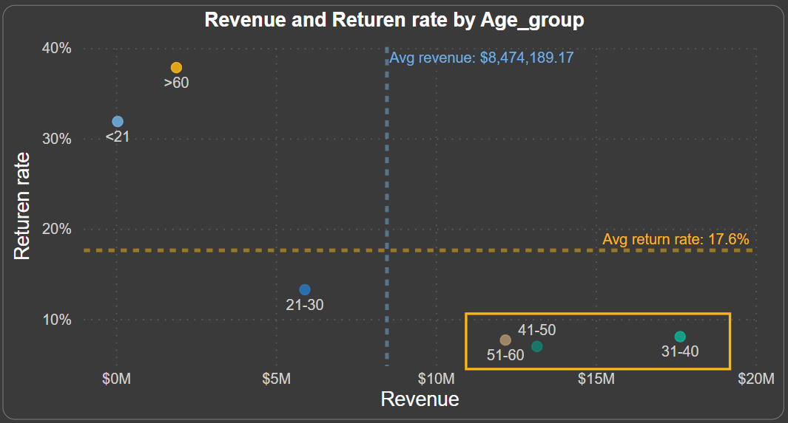
Return Rate 11.7% ➡️ 20%🚩
Filter by Oahu
Notes:
Oahu hotel's revenue and return rate by reservation type and age group. Couples generate the most revenue with a lowest return rate, singles have a lower revenue but highest return rate, and families contribute the least revenue with the moderate return rate. Guests aged 31-40 provide the highest revenue with a good return rate, while those over 60 have the highest return rate but contribute less revenue.
To optimize Oahu's hotel performance:
1. Enhance Loyalty Programs: To achieve the targeted 20% return rate, implement loyalty incentives, particularly for families and singles.
2. Target Families: Address the low engagement of family reservations with tailored experiences and offers.
3. Capitalize on 51-60 Age Group: Increase the return rate of this high-revenue age group through personalized marketing and benefits.

Slide 8
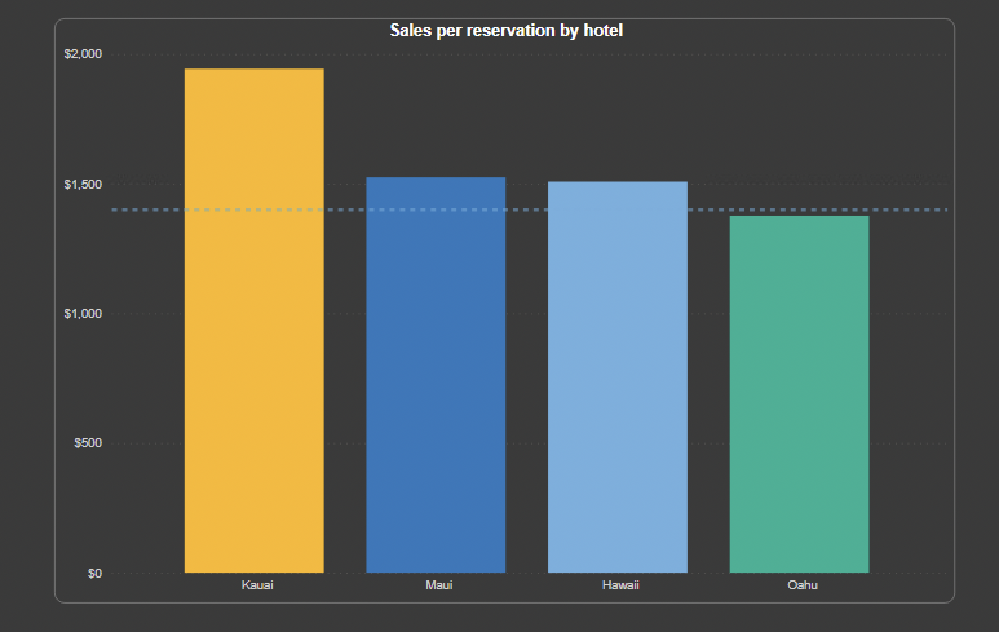
Sales per reservation $1416 ➡️ $2000🚩
Oahu has the lowest sales per reservation
Notes:
Oahu has the lowest sales per reservation when compared to other hotels, despite having a significantly greater revenue.

Slide 9
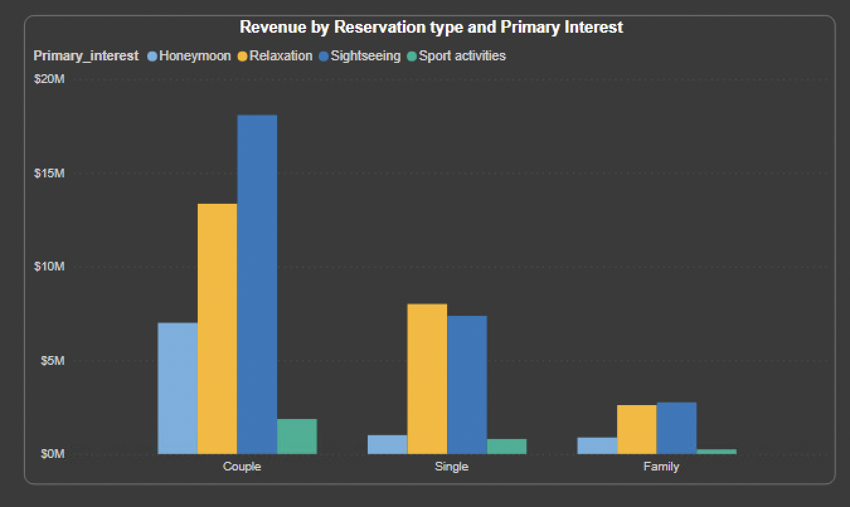
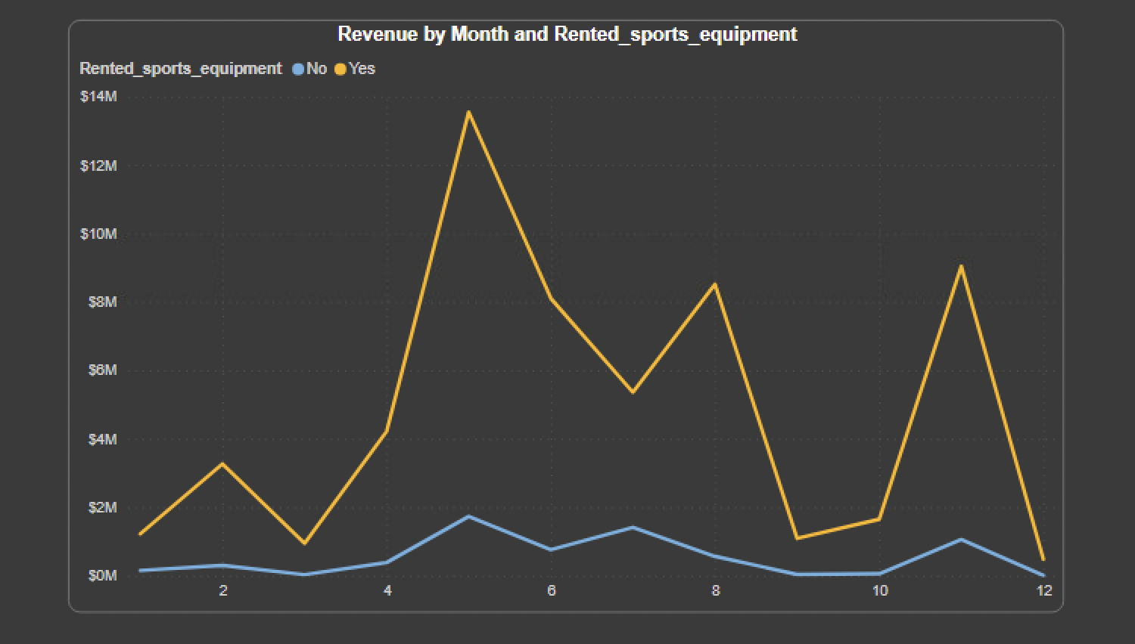
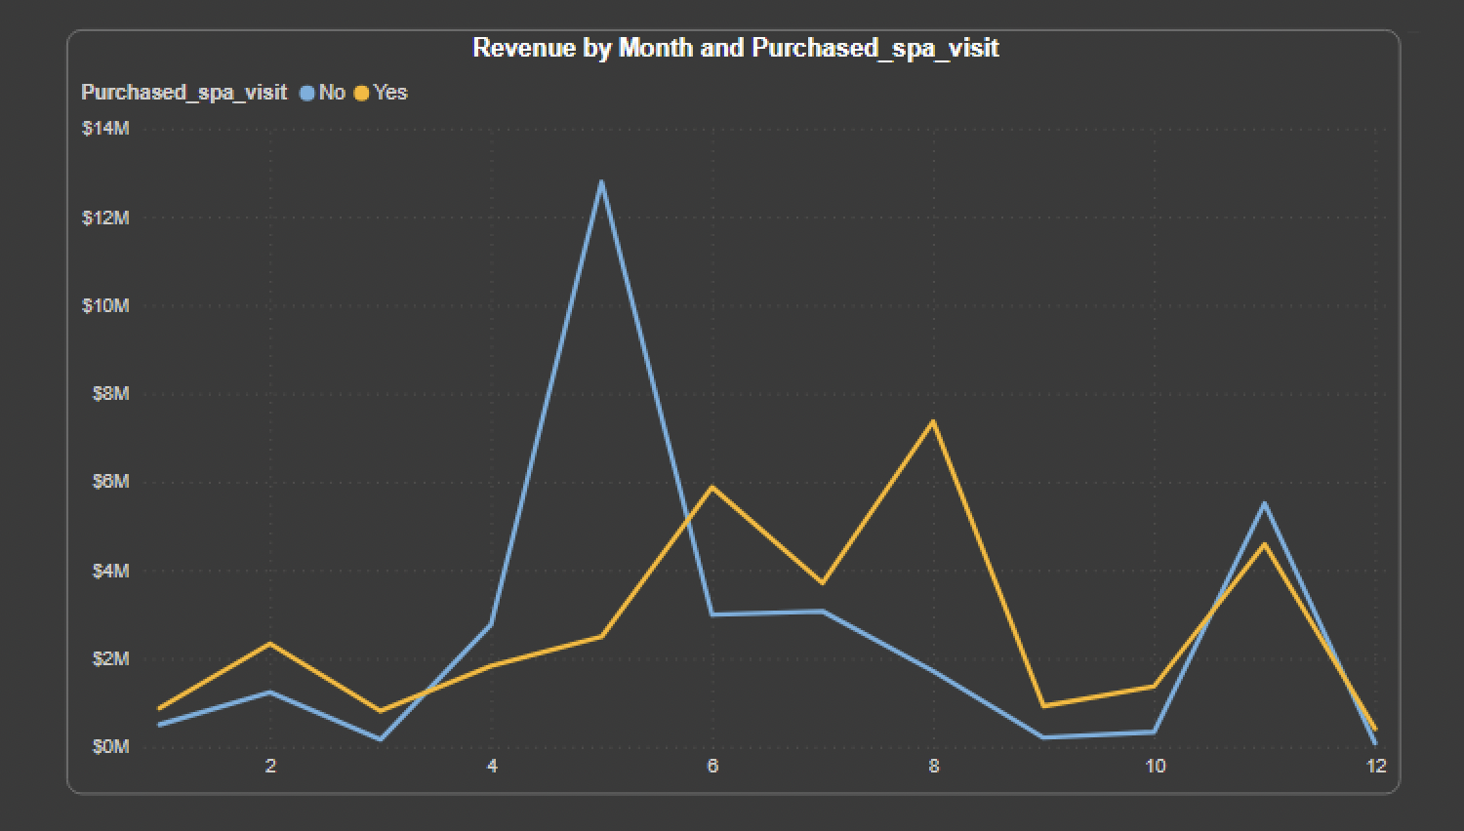
Sales per reservation $1416 ➡️ $2000🚩
Cross-sell additional services or amenities, especially sports packages; promote spa treatments during certain seasons
Expand couple rooms and implement room upgrades
Notes:
When compared to other hotels, Oahu has the highest revenue throughout the year but the lowest sales per reservation.
Although it is expected that the average room fee is not expensive, setting room prices that are too low may result in diminished profitability. To maximise revenue, Oahu should analyse market demand, adjust pricing according to factors such as seasonality and events, and employ dynamic pricing techniques.
Oahu can seize opportunities to cross-sell additional services or amenities, such as sports packages, spa treatments, or room upgrades. Sports facilities and couple rooms can be expanded in order to further increase Oahu's earnings. Extra promotions can be offered for spas from June through October.
Investing in modern facilities and unique experiences can justify higher room rates, while encouraging guests to spend more time during their stay can enhance overall revenue per reservation.

Slide 10
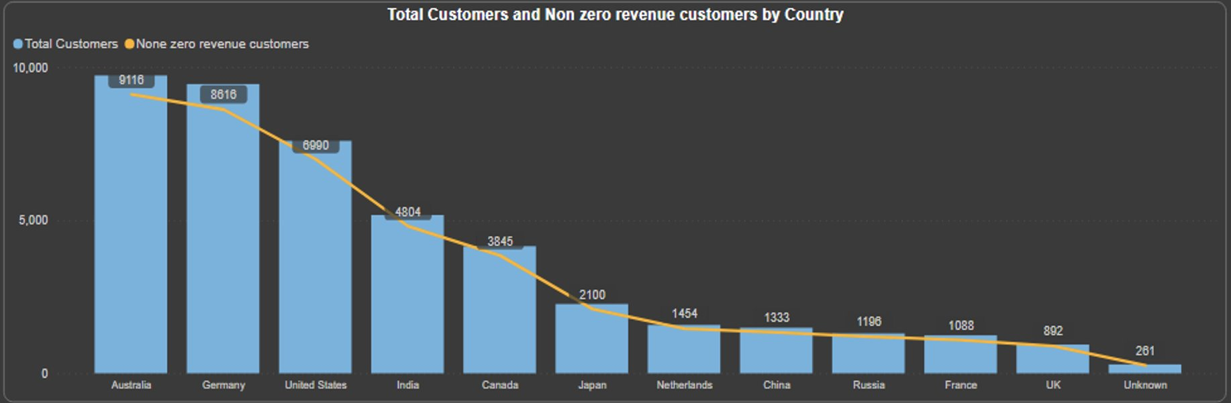
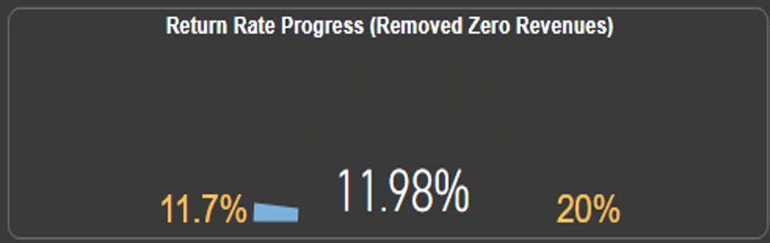
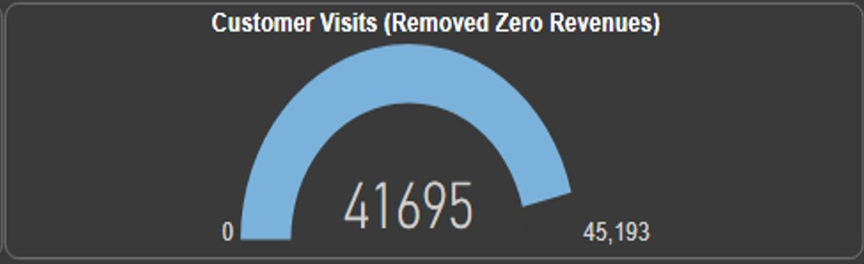
How Zero Revenue Reservations affects the Numbers?
Notes:
By looking at the TableSet, We found that there were reservations that have $0 Revenue.
So then we try to find similarities among the reservations with revenue $0 with different factors such as Primary Interest, Spa-Sports, Reservation Type, Hotels, Gender, Country, etc.
But there were no similarities according to us, Then we wonder what would happen if we don't consider the Zero Revenue Reservations.
Will it affects any indicators(graphs).
Then we created DAX measures involving Non-Zero Revenue Reservations.
In the First Chart,
We compare Country with or without 0 Revenue based Customers. Here you see There is huge decline in countries like Australia, Germany, United States but not much in Russia France.
In the 2nd Chart, Calculating the Return Rate withour 0$ Revenue Reservations with DAX measure.
We can clearly see that Return rate has increased if we don't consider the Zero Revenue Reservations.
Third one is clearcut decrease of Total Customers as we are not considering the those Reservations.

Slide 11
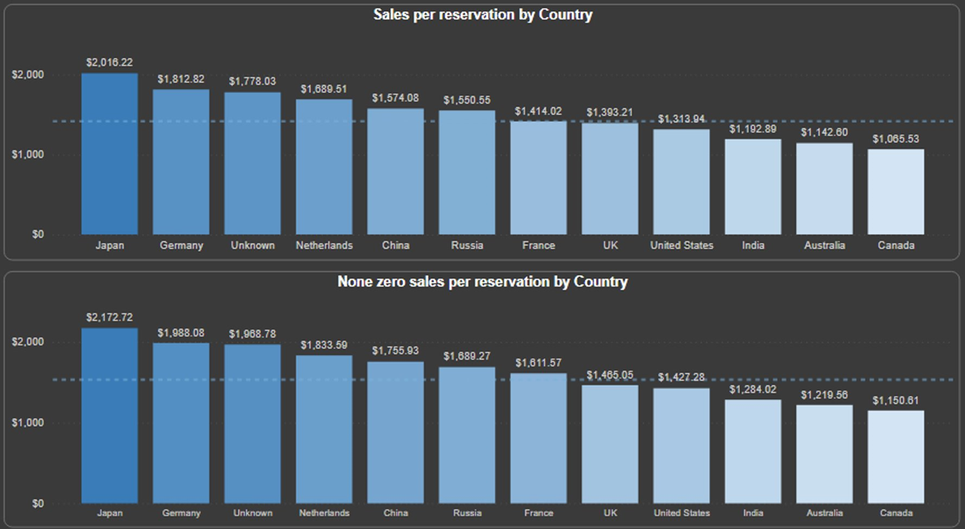
How Zero revenues Reservations affect Sales Per Reservation?
Notes:
After having look at the other factors, Sales Per Reservations is also important. As it provides which country or hotel or any other factor are actually contributing to our sales.
This Two Graphs Represent the Comparison, If we take Sales Per Reservations considering the Zero Revenue Reservations and If we exclude those reservations.
By looking at this chart, It is very hard to find what the difference is but there is a crucial change that the company needs to focus.
Sales Per Reservations including $0 Revenue is $1416 and excluding $1534
Here you see, If we take $0 revenue reservations, France indicates an Below Average(Sales per Reservation) but if we exclude those reservations France will be considered above average when it comes to sales per Reservations.

Slide 12
Recommendations
Customer Return Rate
Focusing on the Analysis that provides why Oahu is not performing well in terms of Return Rate.
Offering new offers to the customers who visited the island.
Customer Visits
Strengthen Marketing Campaigns (U.K., France and Russia)
Increase Landscape pictures which are preferred by age group (<21 or >50) in advertising
Design and implement campaigns that cater to women's aesthetics tastes
Enhance the website interface and use it for sharing new plans.
Sales Per Reservations
Evaluate current Pricing strategy and revenue management practices.
Analyse market trends and competitor pricing to identify opportunities for price adjustment.
Enhance overall Guest Experience by offering value-added services such as sports packages, exclusive spa experiences, or dining promotions. Especially in Oahu Hotel.
Big Idea
By Investing in these Recommendations, Company can not only achieve its target in terms of different factors (profit maximization) but also can prevent customer dissatisfaction and negative reputation regarding pricing.
Notes:
These are some Helpful Recommendation that we think can help Contoso to achieve their targets.
Assumption : Zero Revenue Reservations are taken into account for these 3 Targets. As we are not sure yet why those Revenue exists.

